Slide 1
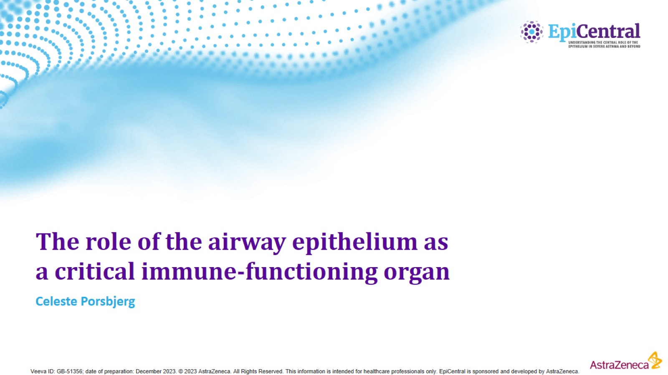
The role of the airway epithelium as a critical immune-functioning organ

Slide 2
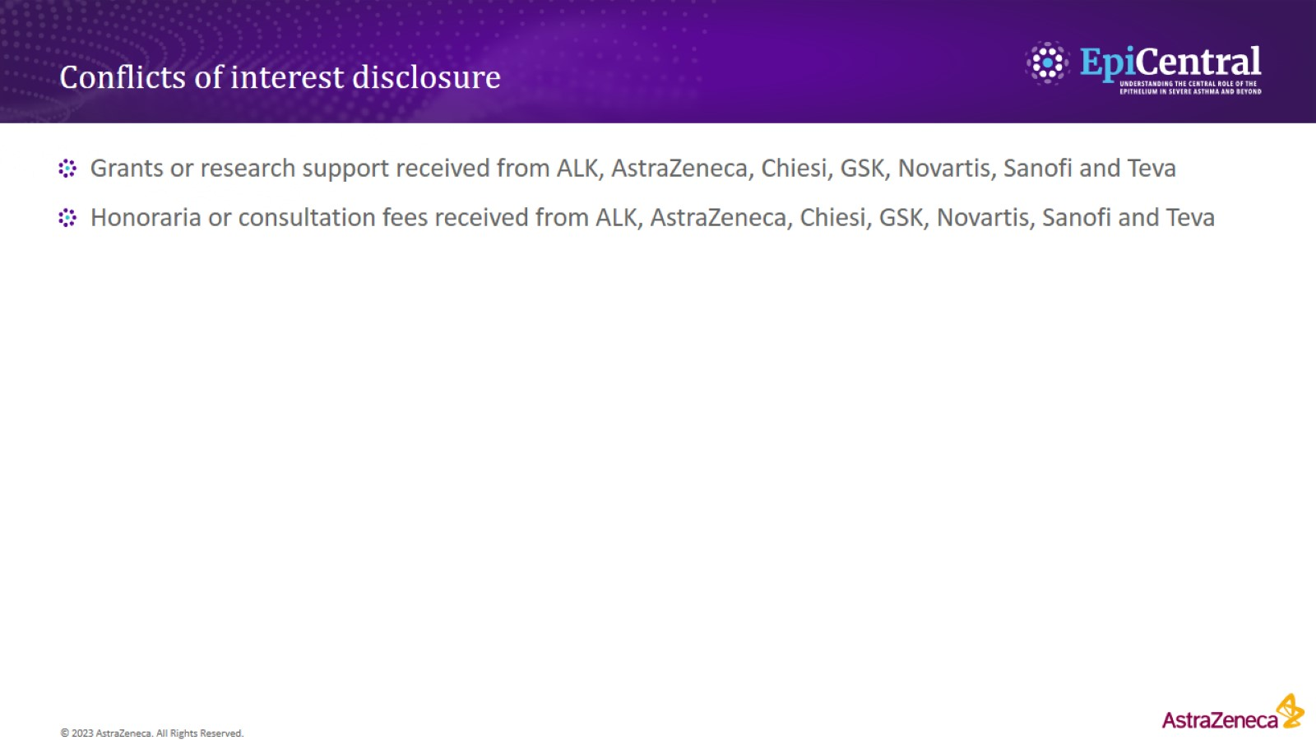
Conflicts of interest disclosure

Slide 3
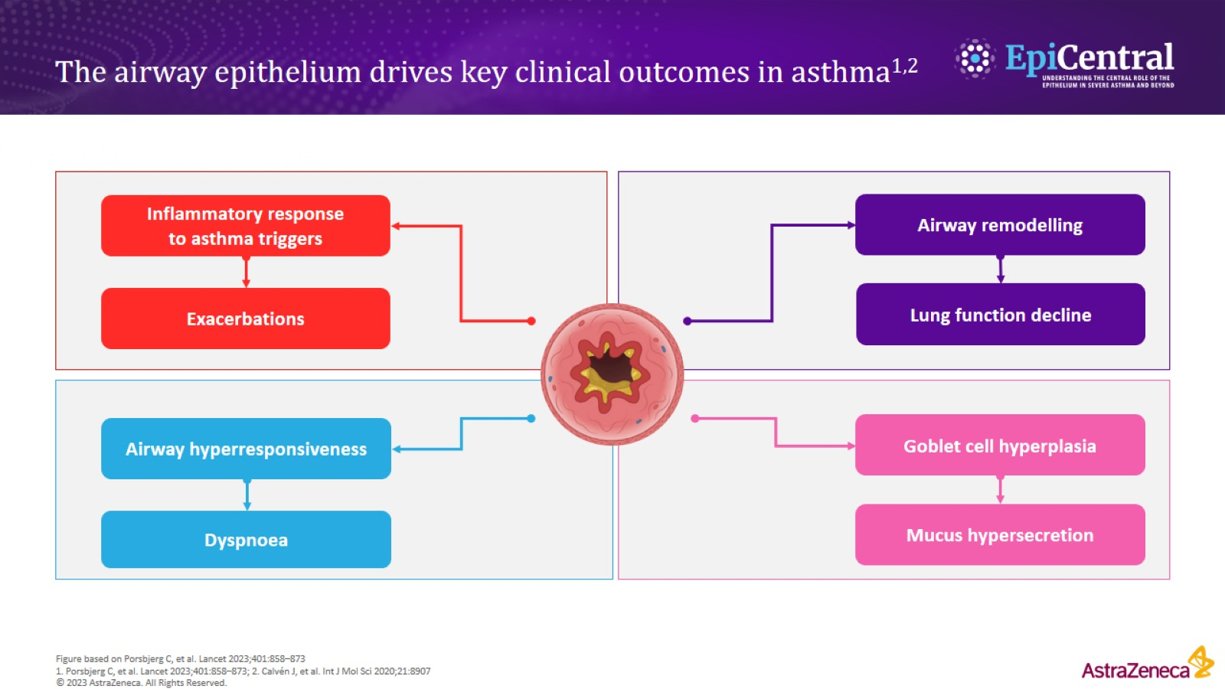
The airway epithelium drives key clinical outcomes in asthma^{1,2}

Slide 4
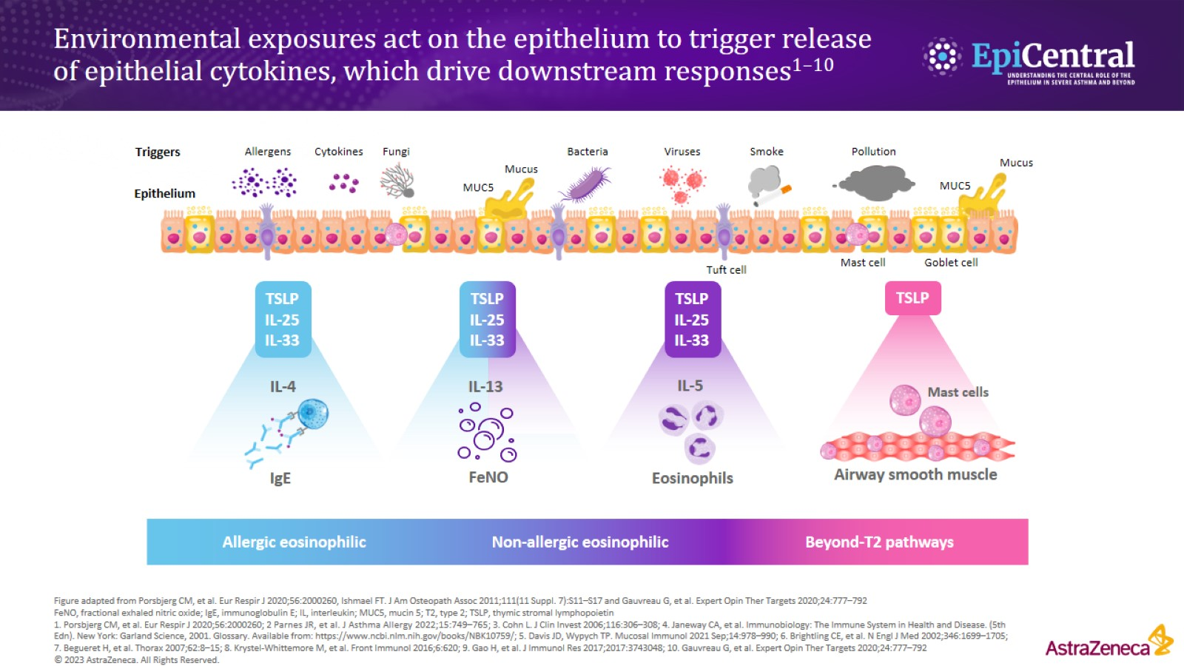
Environmental exposures act on the epithelium to trigger release of epithelial cytokines, which drive downstream responses^{1–10}

Slide 5
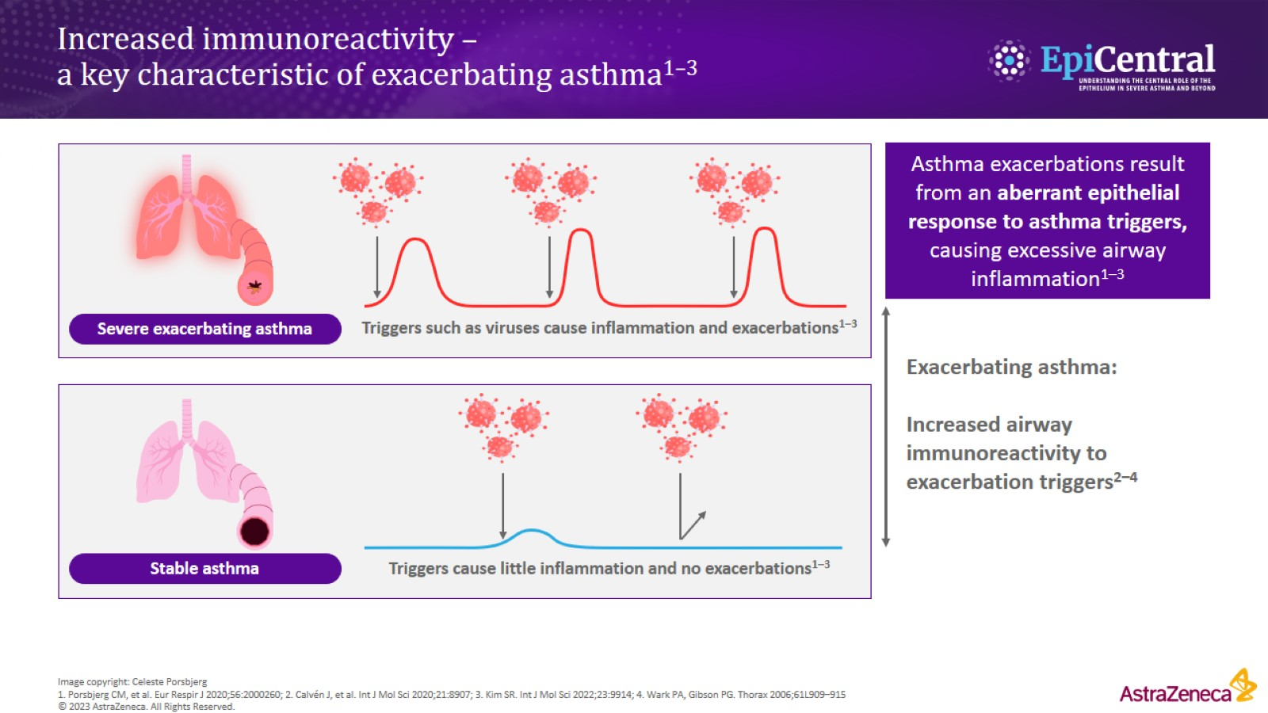
Increased immunoreactivity – a key characteristic of exacerbating asthma^{1–3}

Slide 6
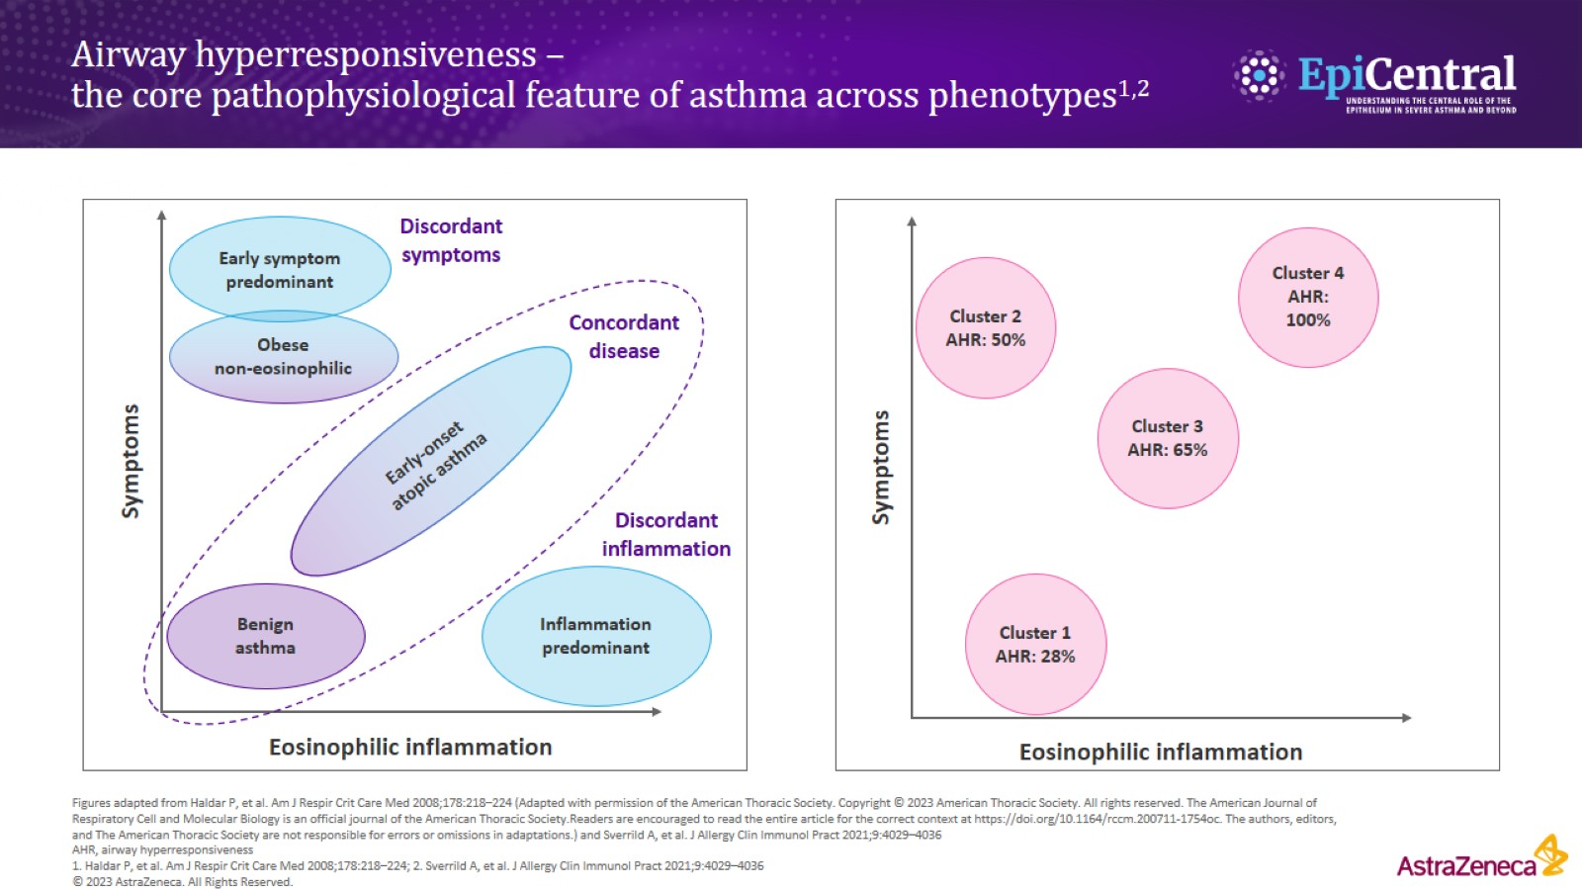

Slide 7
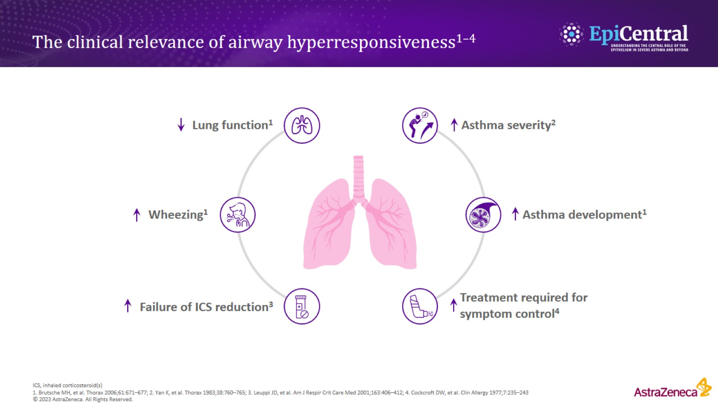
The clinical relevance of airway hyperresponsiveness^{1–4}

Slide 8
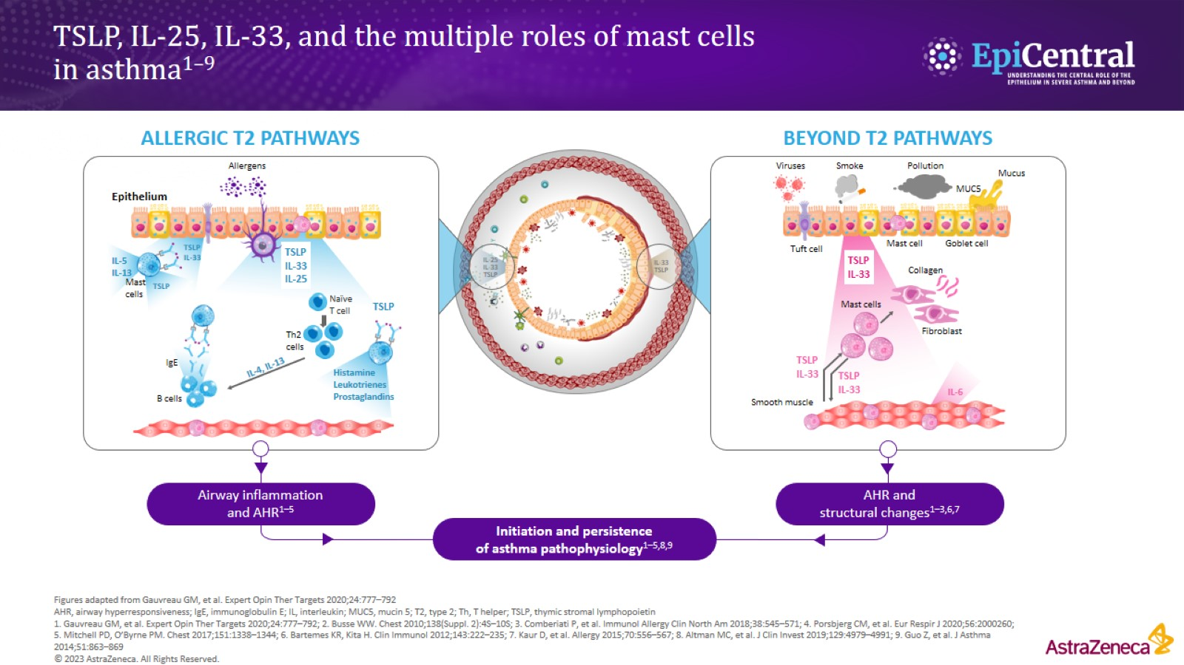
TSLP, IL-25, IL-33, and the multiple roles of mast cells in asthma^{1–9}

Slide 9
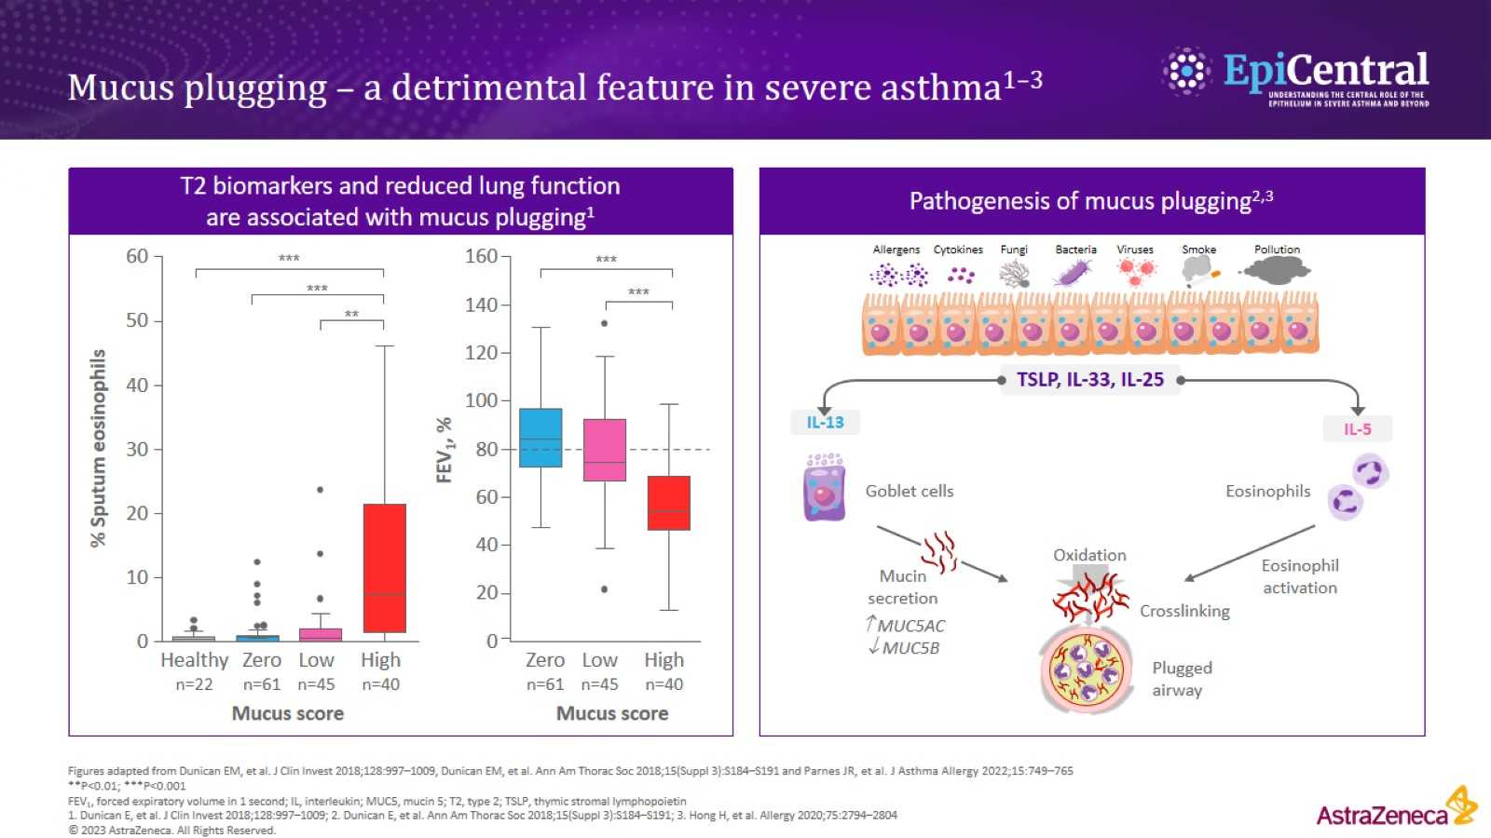
Mucus plugging – a detrimental feature in severe asthma^{1–3}

Slide 10
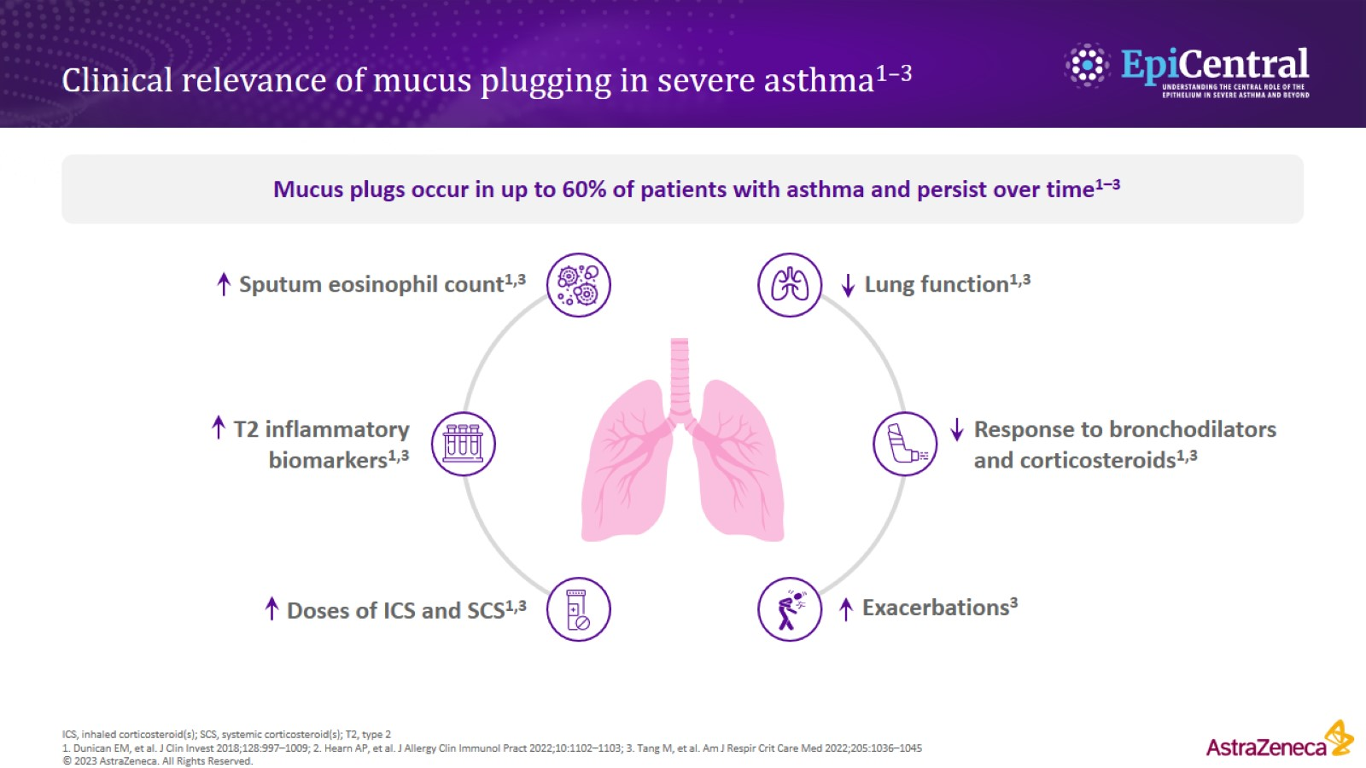
Clinical relevance of mucus plugging in severe asthma^{1–3}

Slide 11
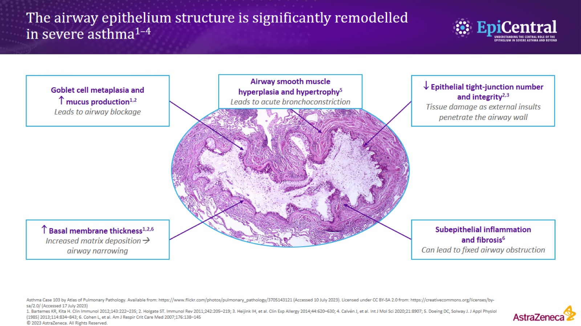
The airway epithelium structure is significantly remodelled in severe asthma^{1–4}

Slide 12
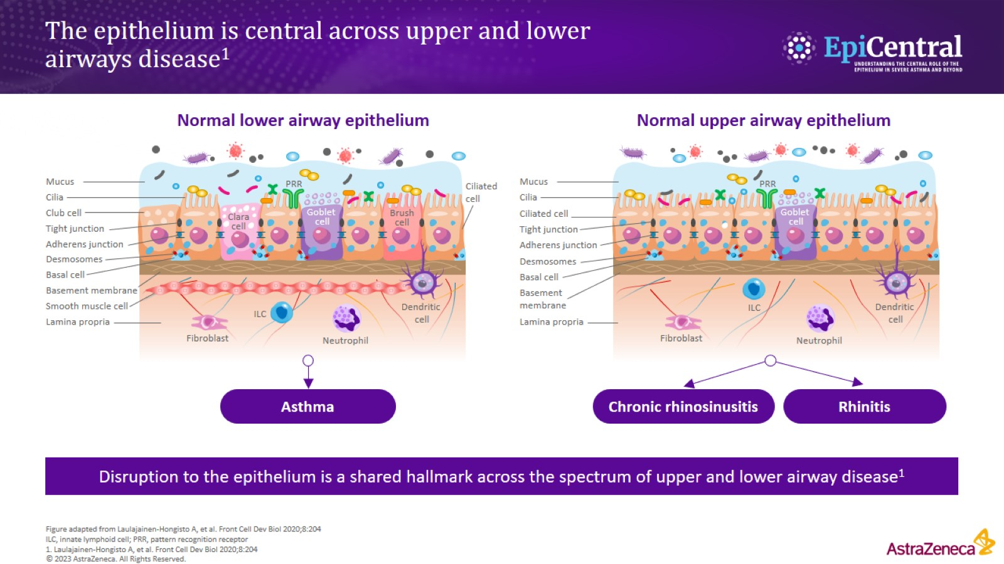
The epithelium is central across upper and lower airways disease¹

Slide 13
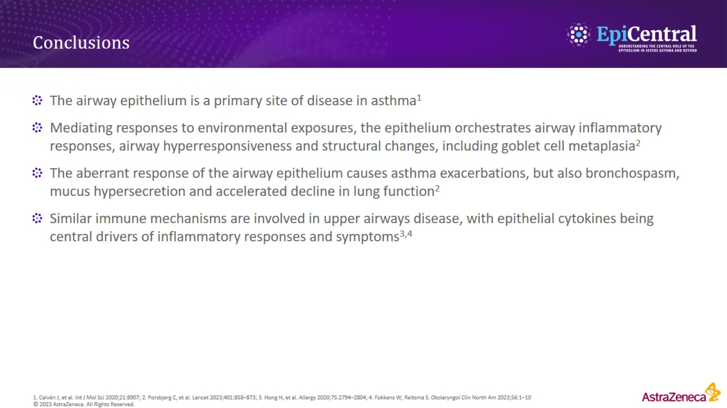
Conclusions

